Slide 1

Software Project Management
Week 1→ Lecture 2
By
Humaira Afzal
Computer Science Department, CUI Lahore Campus

Slide 2
Course Outline
- Introduction to Software Project Management Foundational Elements
- Role of Project Manager

Slide 3
What is a Project?
A temporary endeavor undertaken to create a unique product, service or result.
Notes:
Endeavor - Attempt

Slide 4
What is a Project? (Cont.)
Temporary endeavor.
The Project has a definite beginning and end.
The end of the project is reached when one or more of the following is true:
The project’s objectives have been achieved.
Funding is exhausted or no longer available for allocation to the project.
The need for the project no longer exists
The project is terminated for legal cause or if the client wishes to terminate the project.
Projects are temporary, but their deliverables may exist beyond the end of the project.

Slide 5
What is a Project? (Cont.)
Every project will have
An initiating phase, during which the project infrastructure and goals are drafted.
A planning phase, during which project goals are reﬁned, activities identiﬁed and scheduled, and many other support activities are properly planned.
An executing phase, during which the actual work takes place. Running in parallel, a monitoring phase measures the progress and raises ﬂags when plans and reality disagree.
A ﬁnal closing phase, where the project outputs are handed out and the project is closed.

Slide 6
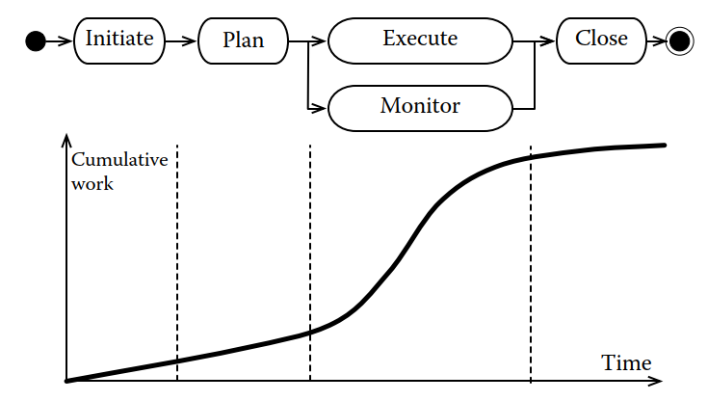
What is a Project? (Cont.)

Slide 7
What is a Project? (Cont.)
Unique product, service, or result.
Projects are undertaken to fulﬁll objectives by producing deliverables.
An objective is deﬁned as an outcome toward which work is to be directed.
a result to be obtained, a product to be produced, or a service to be performed.
A product that can be either a component of an item, an enhancement or a correction to an item.
A service or a capability to perform a service (e.g., a business function that supports production. or distribution)
A result, such as research results or documents.

Slide 8
What is a Project? (Cont.)
Projects constraints
Scope
Quality
Schedule
Budget
Resources and
Risks
An important consequence is that the project manager and the team have to ﬁnd an achievable solution while respecting all project constraints.

Slide 9
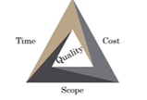
Projects constraints
- The Classic Triple constraint triangle
- Note That these constraints are interrelated, so a strain on one of the core constraints will affect one or more of the other factors.

Slide 10
Examples of projects
Developing a new pharmaceutical compound for the market
Expanding a tour guide service
Acquiring and installing a new computer hardware system for use in an organization
Modifying a computer software program used in an organization
Researching to develop a new Process or improve the existing one.

Slide 11
Practice
Setting up a mobile phone factory
Assembling thousands of mobile phones every day
Putting together a team of research analysts to come up with a design and prototype of a waterproof phone within 6 months.
Manufacturing thousands of these waterproof phones using the design blueprint.

Slide 12
Factors that Lead to the Creation of a Project
- New technology
- Competitive forces
- Market demand
- Customer request
- Organization process improvements

Slide 13
Project, Program, and Portfolio
A project is a temporary endeavour undertaken by a company or organization (such as the creation of a new product, service, or result).
A program is a group of projects that are similar or related to one another and that are often managed as a group instead of independently.
A portfolio is a group of programs and/or projects within the same organization, which may be related or unrelated to one another.

Slide 14
What is Project Management
“Project management is the application of knowledge, skills, tools, and techniques to project activities to meet the project requirements.”
- Project management is accomplished through the appropriate application and integration of the 49 logically grouped project management processes, which are categorized into five process groups.

Slide 15
What is Project Management
Managing a Project Typically includes, but is not limited to
- Identify Project requirements
- Addressing the various needs, concerns, and expectations of the stakeholders – Stakeholder Management
- Balancing the competing project constraints.
The Project manager and team need to be able to assess the situation, balance the demands, and maintain communication with stakeholders to deliver a successful project.
-

Slide 16
The Role of Project Manager
The Project Manager is the person assigned by the performing organization to lead the team that is responsible for achieving the project objectives.
Responsibilities
- Define Project Scope and determine available resources.
- Develop Project Plan that encourage the team to work with full potential.
- Set realistic deadlines and communicate with the team.
- Estimate, Monitor and control the cost of the project.
- Maintain effective communication with the stakeholders

Slide 17
The Role of Project Manager
Responsibilities
Identify, evaluate and take steps to minimize the project risks.
Monitor and control the team performance for efficient results.
Present elaborative reports about the progress of project to stakeholders.

Slide 18
Project Manager
Qualifications
Excellent communication skills
Problem-solving and leadership skills
Project planning, risk management, time management and other project management skills.
Project management professional certification (PMP), Certified Associate in Project Management (CAPM), or equivalent experience as a project manager
Proficiency in project management software and tools
Contract negotiation
Conflict resolution experience.

